Slide 1

Design Patterns: Prototype Pattern
Presented by Timothy Fair & Vladimir Ivanov

Slide 2



Agenda
What is the prototype pattern?
What problem does it solve?
UML Diagram of Prototype
Implementation in Java
Conclusion

Slide 3

What is the Prototype Pattern?

Slide 4
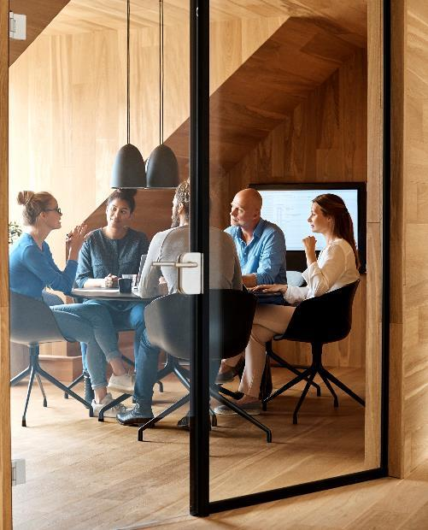



Definition
The prototype pattern allows cloning of objects whose instantiation might otherwise be resource intensive.
An example is pulling data from a database, which is costly unless we pull once and locally clone the object with the data within it.

Slide 5
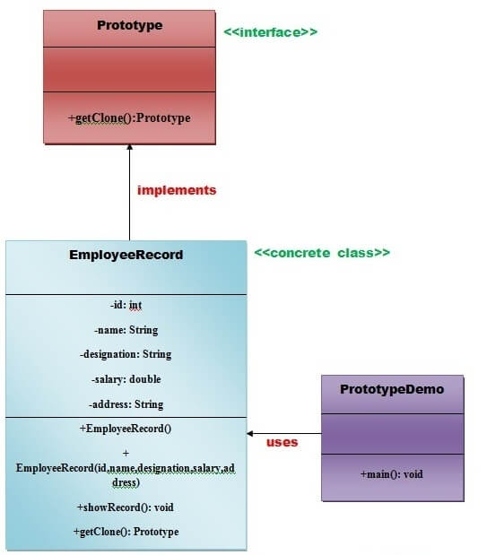
UML Representation: Prototype Pattern

Slide 6
Team
Timothy Fair
Vladimir Ivanov

Slide 7
Content (Any ideas what to place here?)
Subtitle
Subtitle
Add text, images, art, and videos.
Add transitions, animations, and motion.
Save to OneDrive, to get to your presentations from your computer, tablet, or phone.
Open the Design Ideas pane for instant slide makeovers.
When we have design ideas, we’ll show them to you right there.

Slide 8
Content 2
Subtitle
subtitle
subtitle
Add text, images, art, and videos.
Add transitions, animations, and motion.
Save to OneDrive, to get to your presentations from your computer, tablet, or phone.
Open the Design Ideas pane for instant slide makeovers.
When we have design ideas, we’ll show them to you right there.
Add text, images, art, and videos.
Add transitions, animations, and motion.
Save to OneDrive, to get to your presentations from your computer, tablet, or phone.
Open the Design Ideas pane for instant slide makeovers.
When we have design ideas, we’ll show them to you right there.
Add text, images, art, and videos.
Add transitions, animations, and motion.
Save to OneDrive, to get to your presentations from your computer, tablet, or phone.
Open the Design Ideas pane for instant slide makeovers.
When we have design ideas, we’ll show them to you right there.

Slide 9

Summary
The prototype pattern implements avoids using the ‘new’ keyword and unnecessary creation of additional expensive objects in a program. E.G. pulling down data from a database which involves server calls, or objects whose instantiation requires deep calculations before they are made.

Slide 10


Thank You
Timothy Fair, Vladimir Ivanov

